Slide 1
Binary Trees
Chapter 11
Notes:
1

Slide 2
Chapter Contents
Introduction
Implementing Binary Search Trees
Binary Search Tree Traversal Algorithms
Binary Search Trees Building Algorithms
Binary Search Trees Applications

Slide 3
Objectives
Explore various binary search tree traversal algorithms
Learn how to organize data in a binary search tree
Discover how to insert and delete items in a binary search tree

Slide 4
The BinaryTree Abstract Data Type
BiaryTree ADT
DATA
*root : BinaryTreeNode
FUNCTIONS
BinaryTree ( )
~BinaryTree ( )
AUXILIARY FUNCTIONS
destroy ( BinaryTreeNode *) : void

Slide 5
Implementing Binary Trees
Pointer to root node is stored outside the binary tree
Each node in a binary tree (including the root node) has at most two children

Slide 6
Binary Tree Node
Each node is a template structure consisting of three fields:
data of a generic data type NodeType
leftChildPtr which is a pointer to the left child
rightChildPtr which is a pointer to the right child

Slide 7
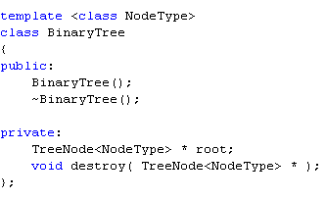
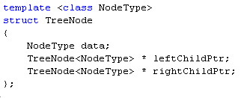
The BinaryTree Class

Slide 8
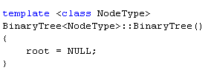
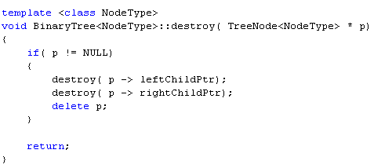
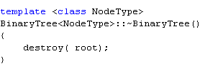
The Constructor and Destructor

Slide 9
Binary Trees Utility Operations
Determine if binary tree is empty
Re-Initialize a binary tree
Find the height of the binary tree
Find the number of nodes in the binary tree
Requires tree traversal
Find the number of leaves in the binary tree
Requires tree traversal

Slide 10
Modified BinaryTree ADT
BiaryTree ADT
DATA
*root : BinaryTreeNode
FUNCTIONS
BinaryTree ( )
isBinaryTreeEmpty( ) : boolean
resetBinaryTree()
getBinaryTreeHeight( int & ) : void
~BinaryTree ( )
AUXILIARY FUNCTIONS
destroy ( BinaryTreeNode *) : void
height(BinaryTreeNode *) : integer
Larger( integer &, integer *) : integer

Slide 11
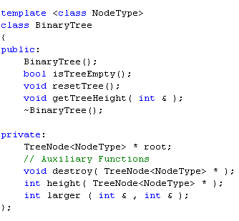
Modified BinaryTree Class

Slide 12
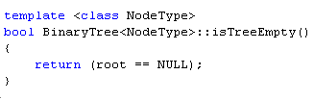
Empty Binary Tree
A binary tree is empty if its root is NULL
Otherwise, the tree is not empty

Slide 13
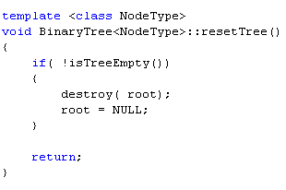
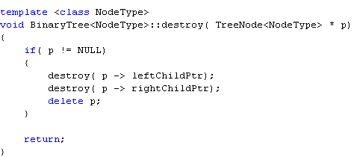
Reset Binary Tree
Reset binary tree to empty state
Uses function destroy to de-allocate memory reserved for tree nodes

Slide 14
Find Binary Tree Height
Uses recursion to find the number of edges on the longest path in the tree
Uses auxiliary recursive function height which in turn uses auxiliary function larger (which returns the larger of two integer arguments)
Auxiliary function height:
Recursive
Returns the height of the subtree to which the argument pointer points

Slide 15
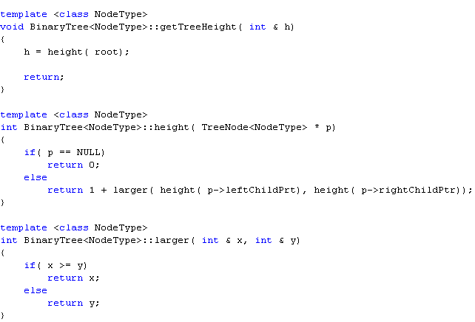
Find Binary Tree Height (Continued)

Slide 16
Binary Tree Traversal
Must start with the root, and then
Visit the node first or
Visit the subtrees first
Three different traversals
Inorder
Preorder
Postorder

Slide 17
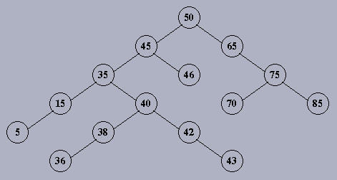
Inorder Tree Traversal
(LNR) Traversal
Traverse the left subtree
Visit the node
Traverse the right subtree
Example:
5 15 35 36 38 40 42 43 45 46 50 65 70 75 85

Slide 18
Preorder Tree Traversal
(NLR) Traversal
Visit the node
Traverse the left subtree
Traverse the right subtree
Example:
50 45 35 15 5 40 38 36 42 43 46 65 75 70 85

Slide 19
Postorder Tree Traversal
(LRN) Traversal
Traverse the left subtree
Traverse the right subtree
Visit the node
Example:
5 15 36 38 43 42 40 35 46 45 70 85 75 65 50

Slide 20
Breadth First Scan
Scan the tree level by level starting at the root and moving to the first generation of children, then the second generation, and so forth
Use a queue to store the nodes
Example:
50 45 65 35 46 75 15 40 70 85 5 38 42 36 43

Slide 21
Implementing Binary Tree Traversals
Traversal algorithms are recursive
Each traversal algorithm is implemented as a function
Each traversal function uses an auxiliary recursive function (helper)

Slide 22
Modified BinaryTree ADT
BiaryTree ADT
DATA
*root : BinaryTreeNode
FUNCTIONS
…
inOrderTraversal ( ) : void
preOrderTraversal ( ): void
postOrderTraversal ( ) : void
…
AUXILIARY FUNCTIONS
…
inOrder ( BinaryTreeNode *) : void
preOrder (BinaryTreeNode *) : void
postOrder ( BinaryTreeNode *) : void
…

Slide 23
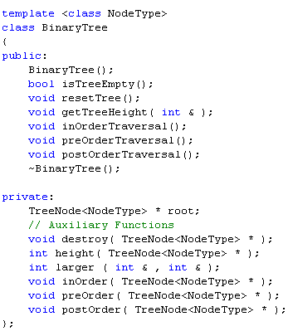
Modified BinaryTree Class

Slide 24
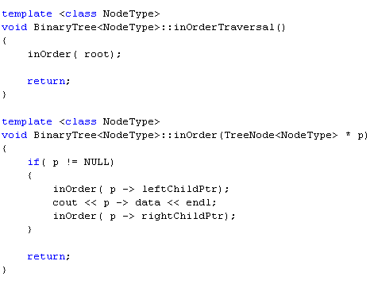
InOrder Traversal

Slide 25
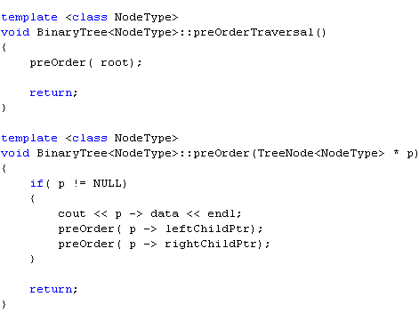
PreOrder Traversal

Slide 26
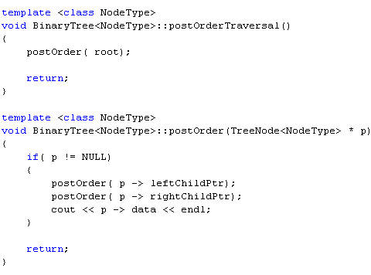
PostOrder Traversal

Slide 27
Binary Trees Utility Operations
Determine if binary tree is empty
Re-Initialize a binary tree
Find the height of the binary tree
Find the number of nodes in the binary tree
Find the number of leaf nodes in the binary tree

Slide 28
Modified BinaryTree ADT
BiaryTree ADT
DATA
*root : BinaryTreeNode
FUNCTIONS
…
countTreeNodes ( ) : void
countTreeLeafNodes ( ): void
…
AUXILIARY FUNCTIONS
…
countNodes : integer
countLeafNodes () : integer
…

Slide 29
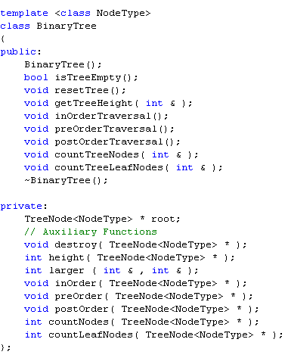
Modified BinaryTree Class

Slide 30
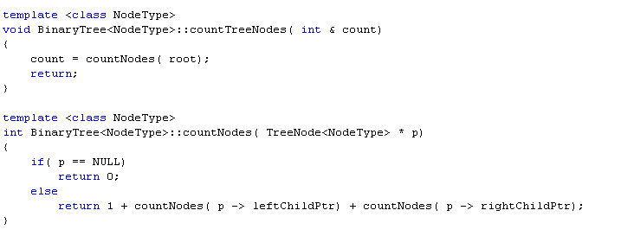
Counting Tree Nodes

Slide 31
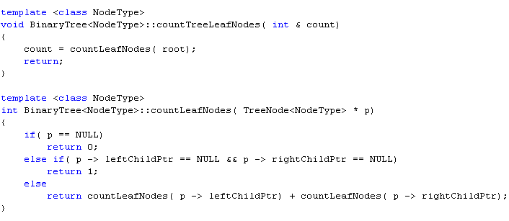
Counting Tree Leaf Nodes

Slide 32
Binary Search Tree Basic Operations
Insert an item in the binary tree
Search binary tree for a particular item
Delete an item from the binary tree

Slide 33
Modified BinaryTree ADT
BiaryTree ADT
DATA
*root : BinaryTreeNode
FUNCTIONS
…
searchTree ( ) : bool
insertTreeNode ( NodeType & ): void
deleteTreeNode ( NodeType & ) : void
…
AUXILIARY FUNCTIONS
…
createNewNode ( NodeType ) : pointer
...

Slide 34
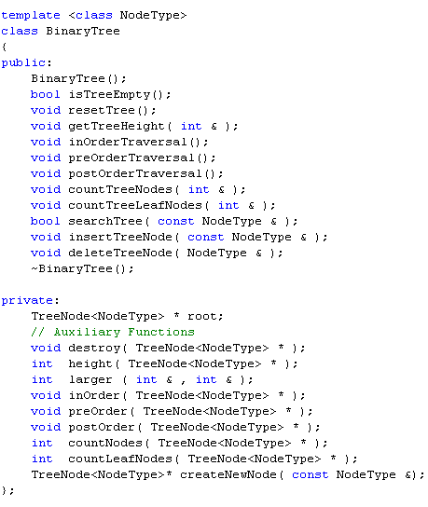
Modified BinaryTree Class

Slide 35
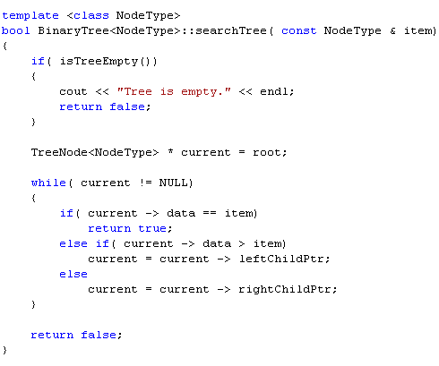
Searching a Binary Tree
Very similar to binary search algorithm
Search a binary search tree for a given item
Return true if item is found
Otherwise, return false

Slide 36
Building Binary Search Trees
Construction Rule
For each node, the data values in the left subtree are less than the value of the node and the data values in the right subtree are greater than or equal to the value of the node.

Slide 37
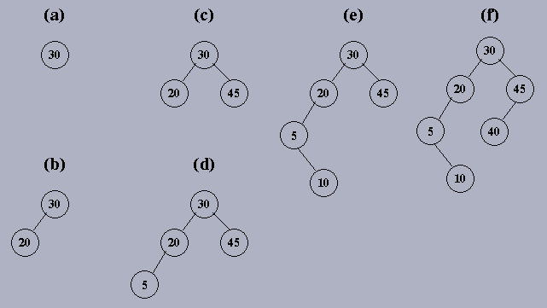
Building Binary Search Trees: Example
Build a binary tree that consists of the nodes: 30, 20, 45, 5, 10, 40.

Slide 38
Building Binary Search Trees: Implementation
After inserting a new node, the resulting tree must remain a binary search tree
To insert a new node:
Search for the correct location where the new node needs to be inserted
Similar to the search algorithm implemented but use two pointers
Create a new node
Insert new node

Slide 39
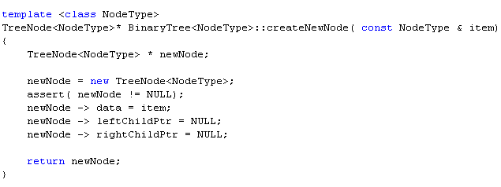
Auxiliary Function createNewNode

Slide 40
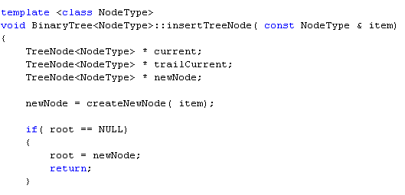
Function insertTreeNode (Part 1/2)

Slide 41
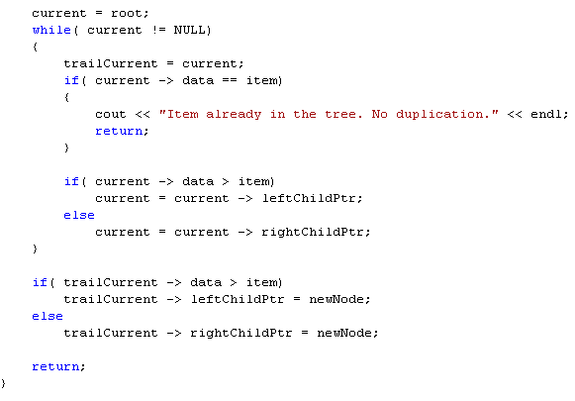
Function insertTreeNode (Part 2/2)

Slide 42
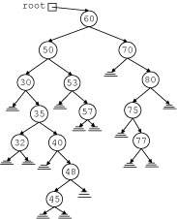
Deleting a Node
To delete a node, we need to search for the node to be deleted
After deleting a node, the resulting tree must remain a binary search tree
Four scenarios could occur depending on whether the left and/or right subtree(s) is empty

Slide 43
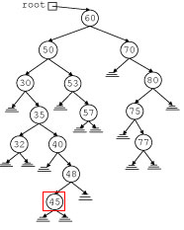
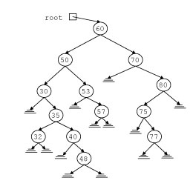
Case 1: Deleting a node that has empty left and right subtrees (Leaf Node)
Delete the node after adjusting the left or right pointer of its parent.

Slide 44
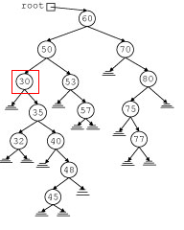
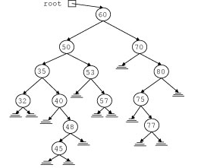
Case 2: Deleting a node that has empty left subtree and a nonempty right subtree
The right subtree of the node to be deleted becomes the left child of its parent.

Slide 45
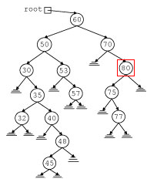
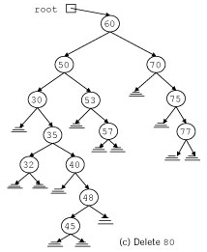
Case 3: Deleting a node that has empty right subtree and a nonempty left subtree
The left subtree of the node to be deleted becomes the right child of its parent.

Slide 46
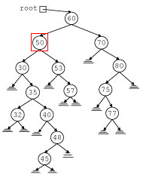
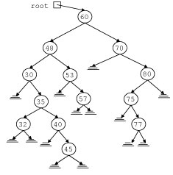
Case 4: Deleting a node that has nonempty left and right subtrees
The node to be deleted is replaced by the rightmost child in its left subtree. Apply either Case 2 or 3 to the node to be moved.

Slide 47
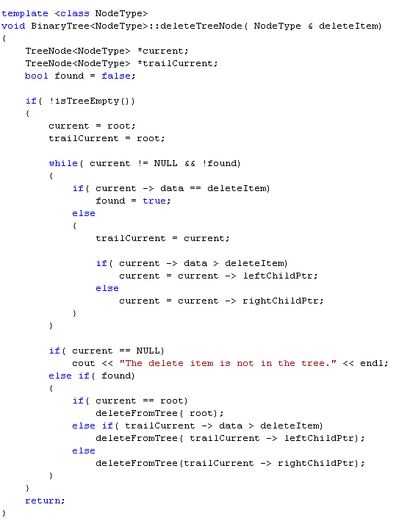
Deleting a Node
Search for the node to be deleted
The search algorithm is similar to the search algorithm implemented but use two pointers

Slide 48
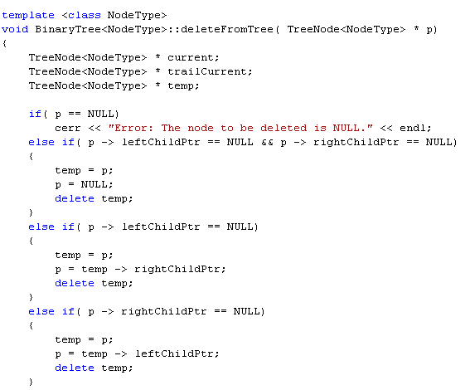
Deleting a Node (Part 1/2)
Delete the node after adjusting pointers of the parent (Cases 1 through 3)

Slide 49
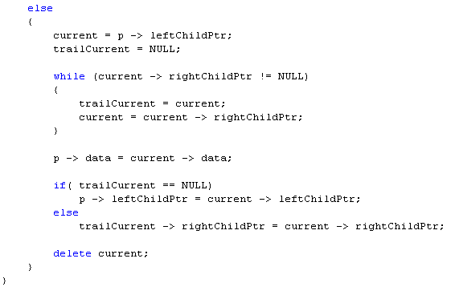
Deleting a Node (Part 2/2)
Delete the node after adjusting pointers of the parent (Case 4)

Slide 50
Section 2- End

